Slide 1
Orange

Slide 2
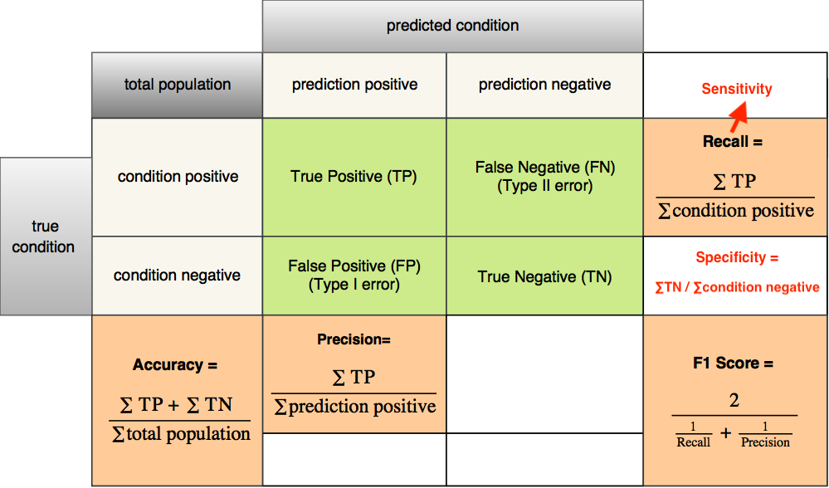
Measurement of a model on test set: Accuracy (For Classifier), for continuous, using RMSE
https://images.app.goo.gl/yGHjQrE27emHFTRd7

Slide 3
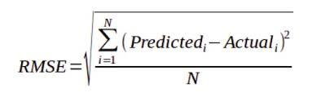
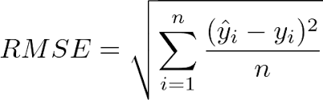
Continuous aka Regression Y
MSE
RMSE

Slide 4
Install the software
https://orangedatamining.com/

Slide 5
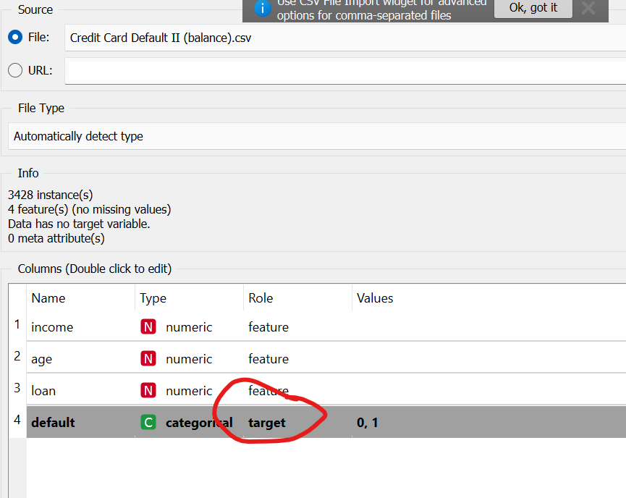
Upload Data – File (note if you use read csv, then need to select columns) – Try to use File

Slide 6
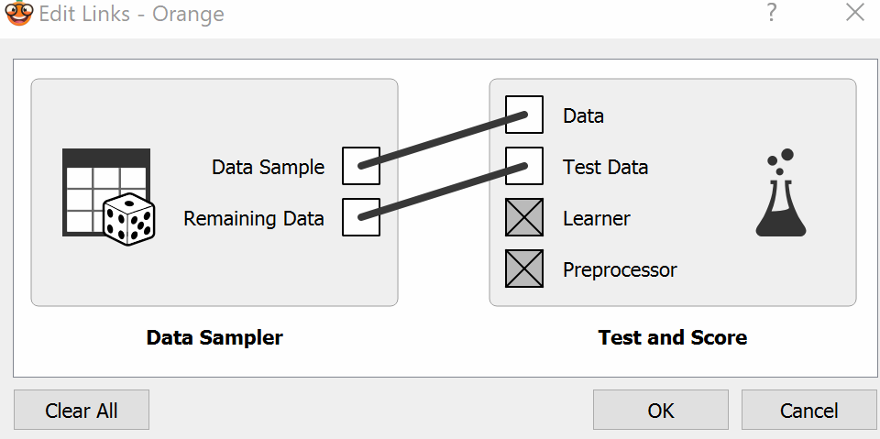
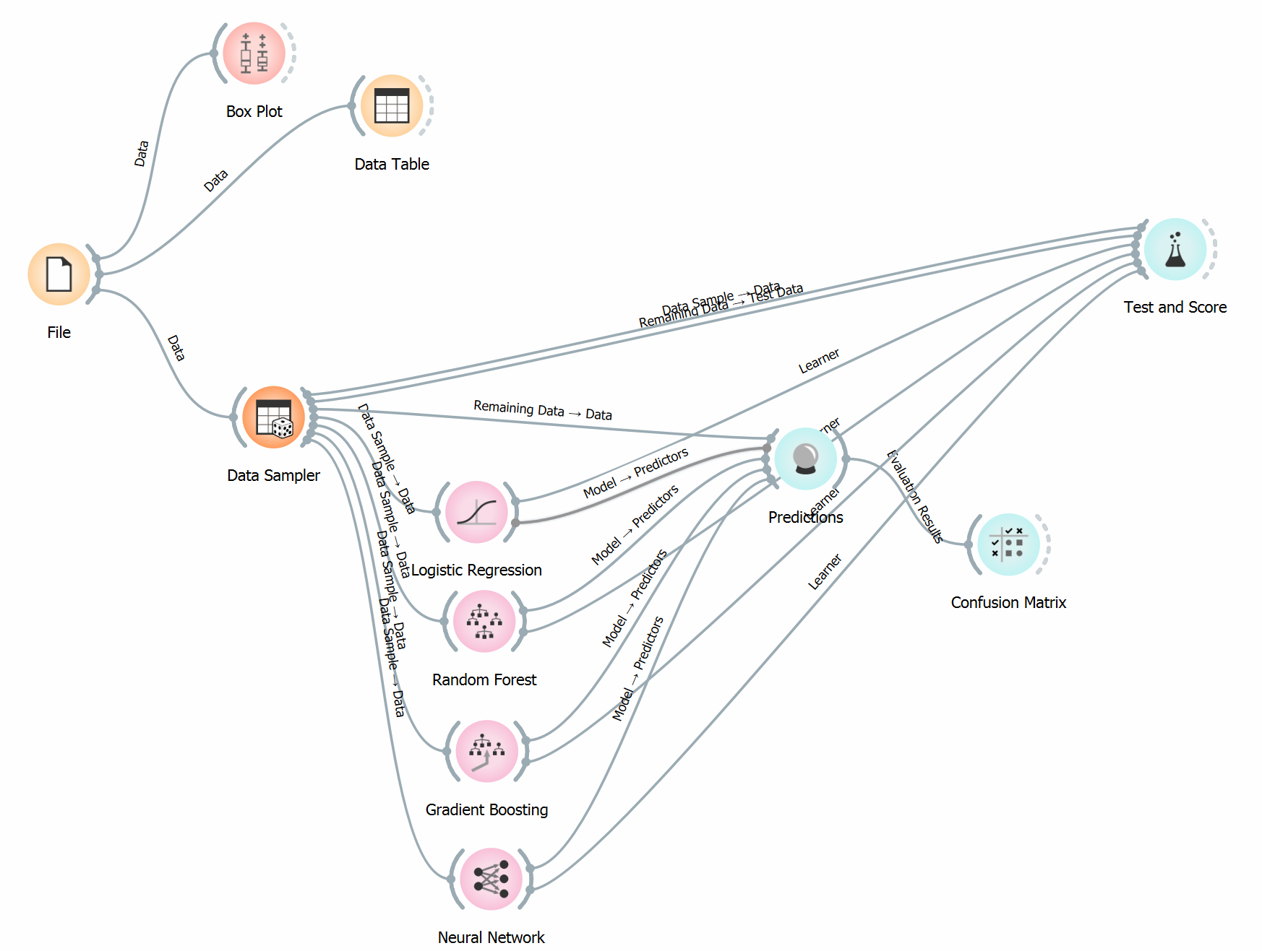
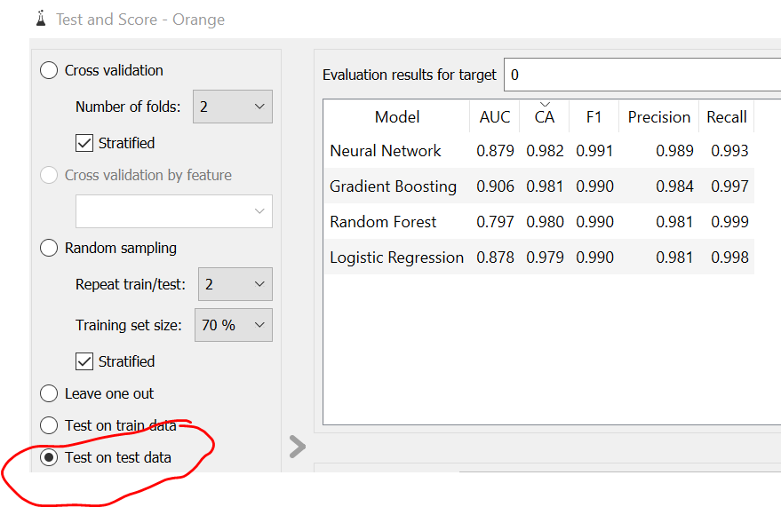
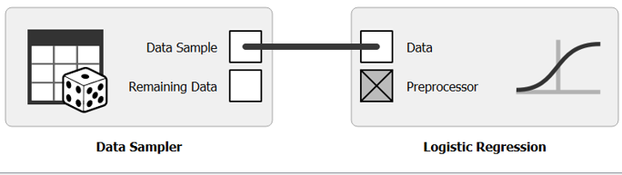
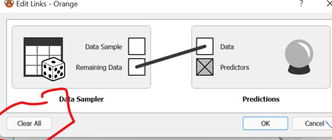
Split train test (Categorical)

Slide 7
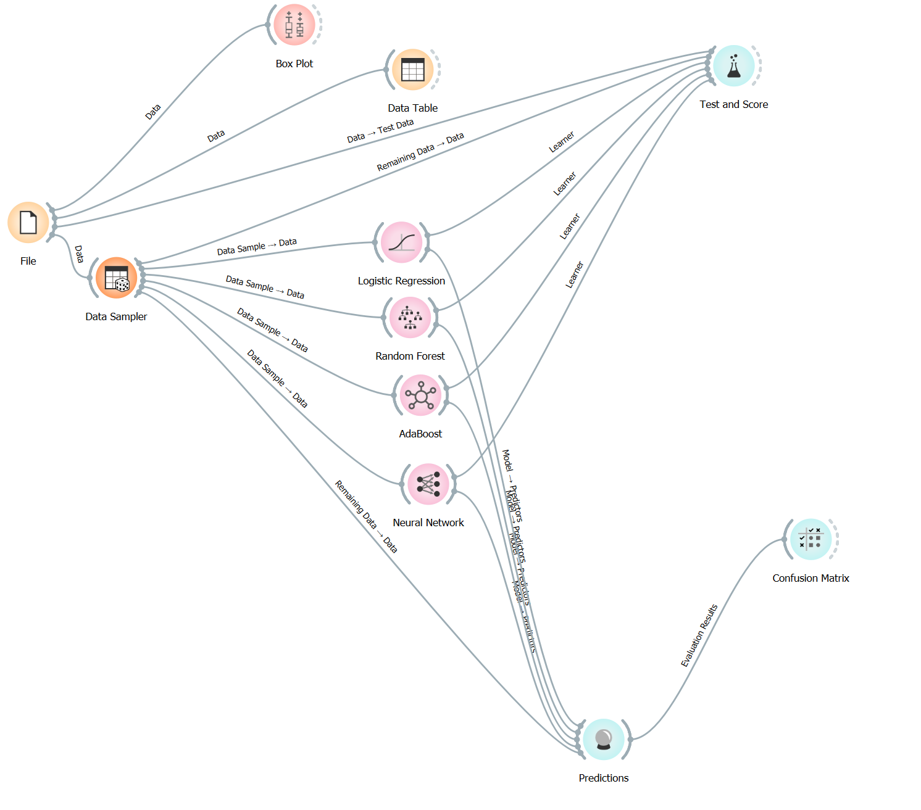
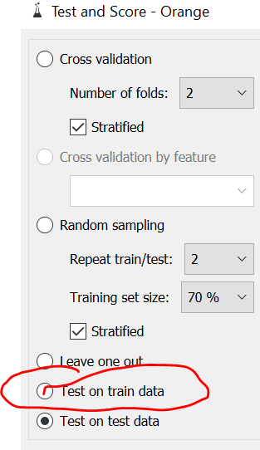
without split train test (Categorical)

Slide 8
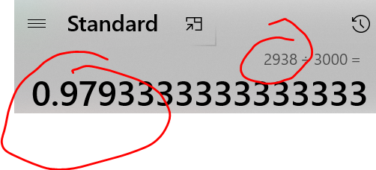
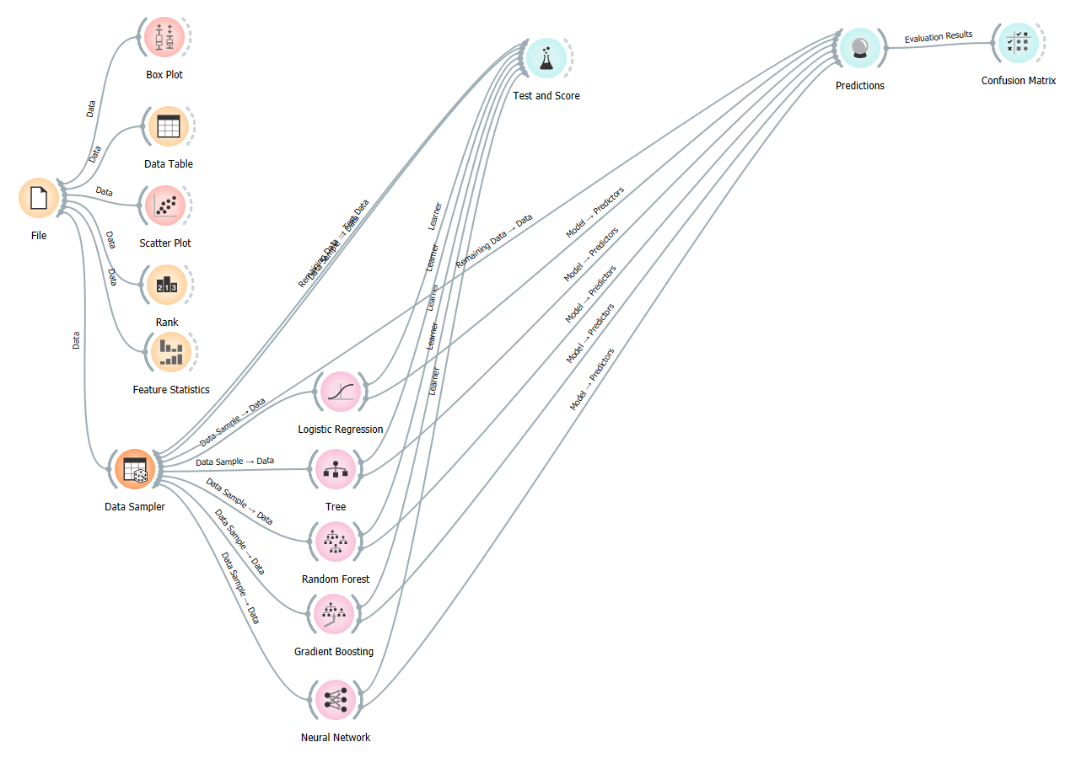
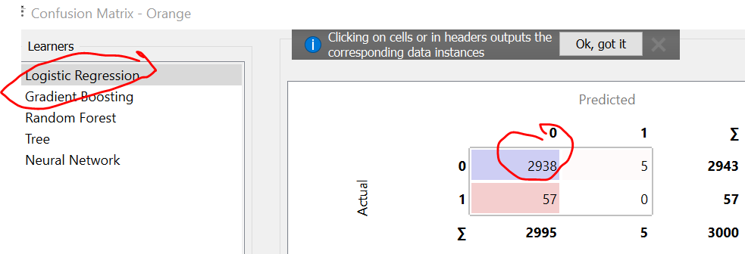
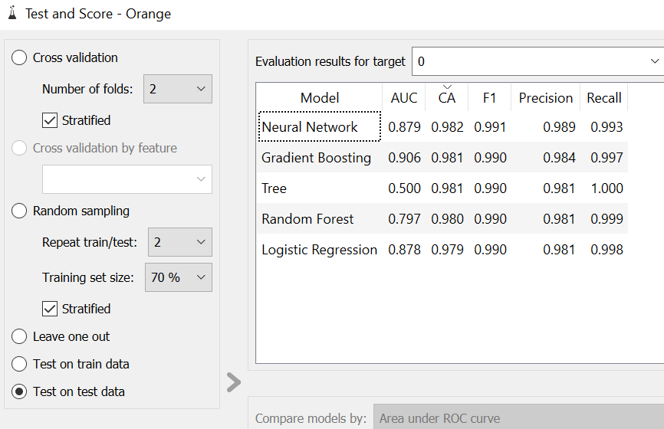
Bankruptcy
2938

Slide 9
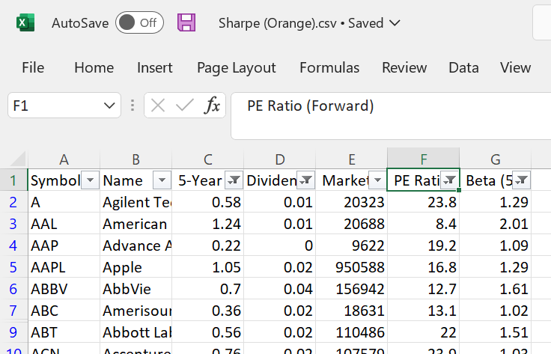
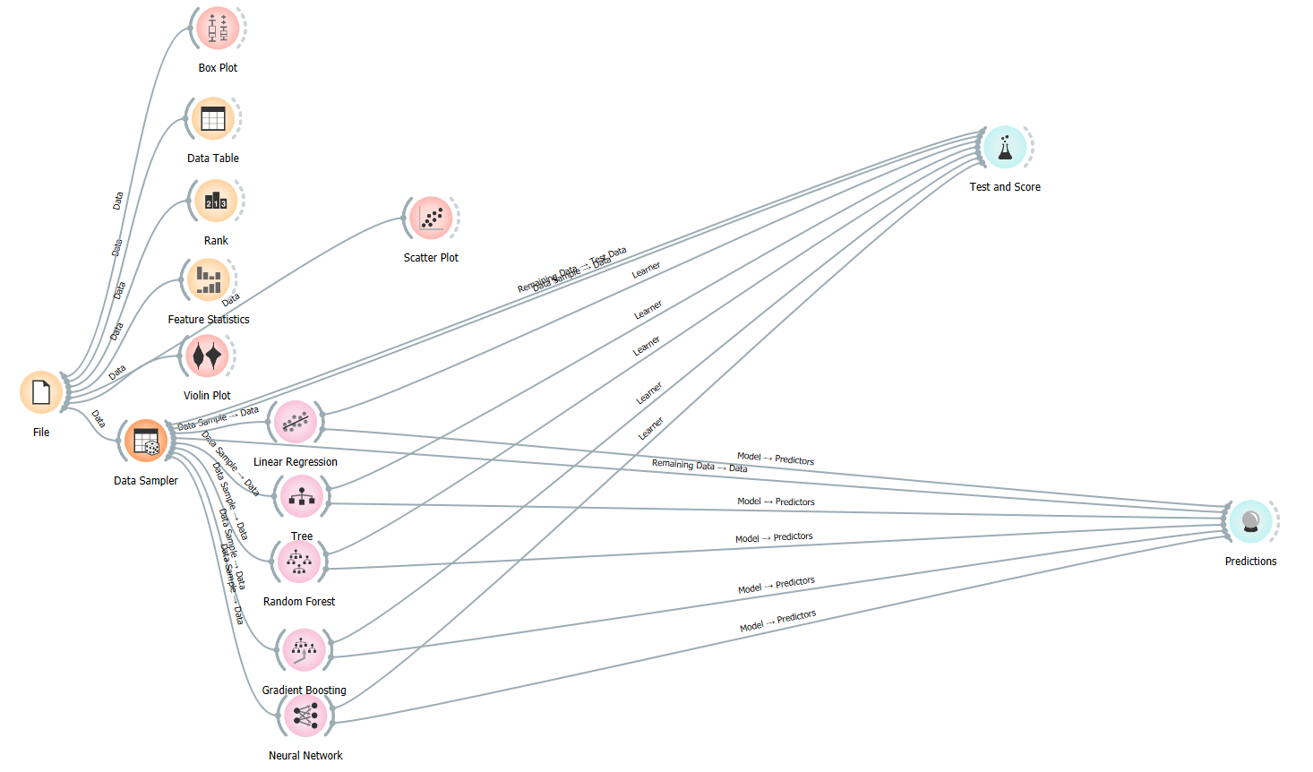
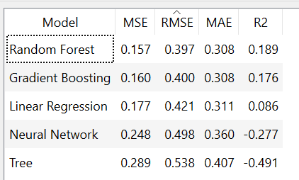
Sharpe
Remove NA, save as new file name

Slide 10
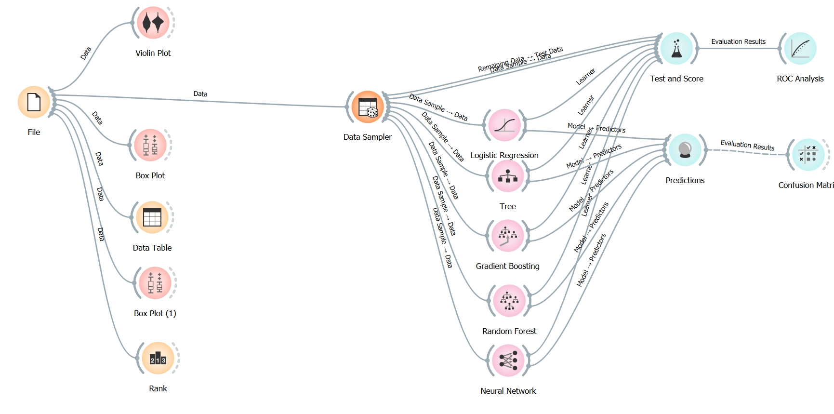
Loan Default II

Slide 11
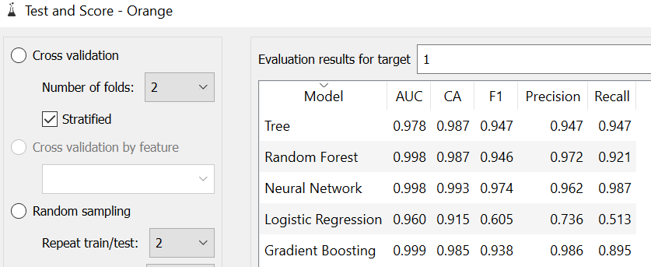
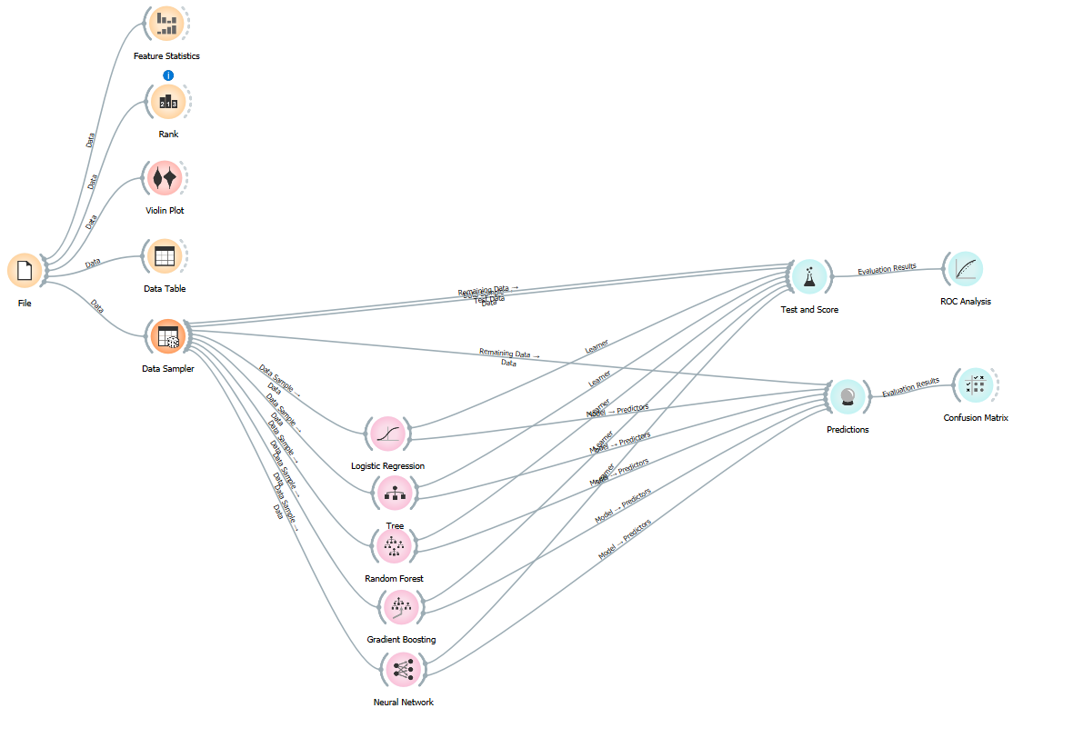
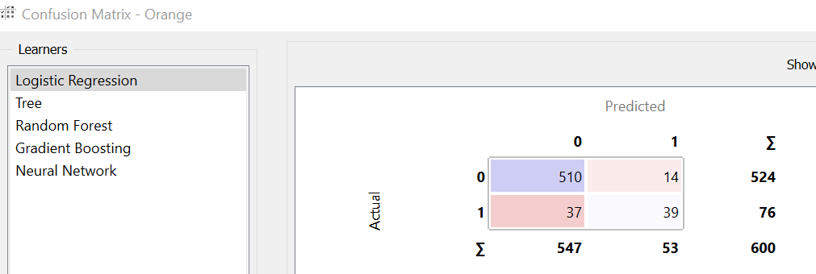
Credit Card Default II

Slide 12
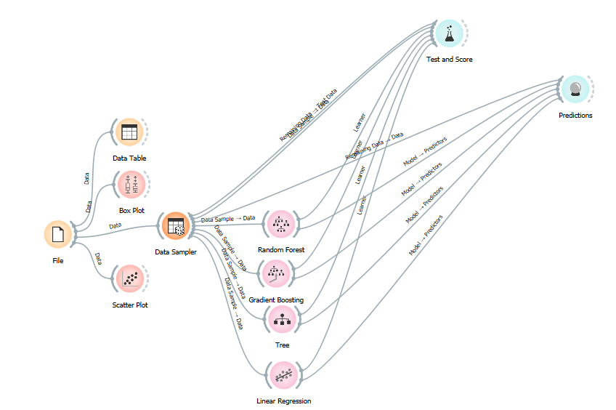
Treynor Ratio

Slide 13
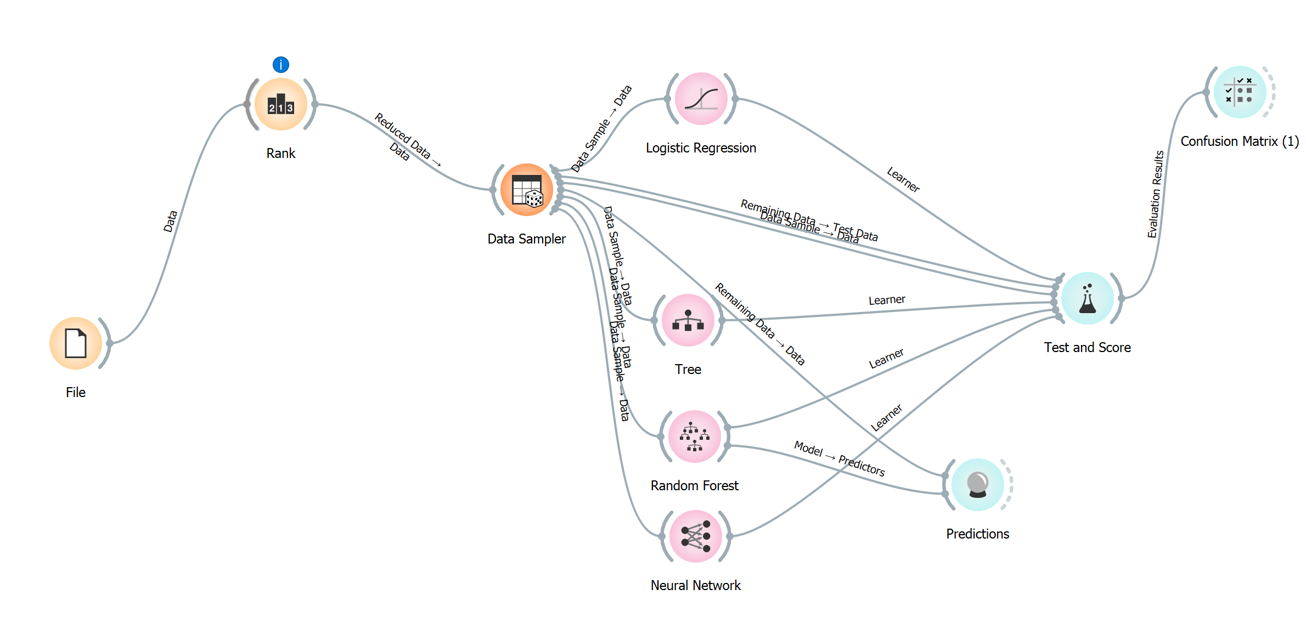
Equity

Slide 14
Text

Slide 15
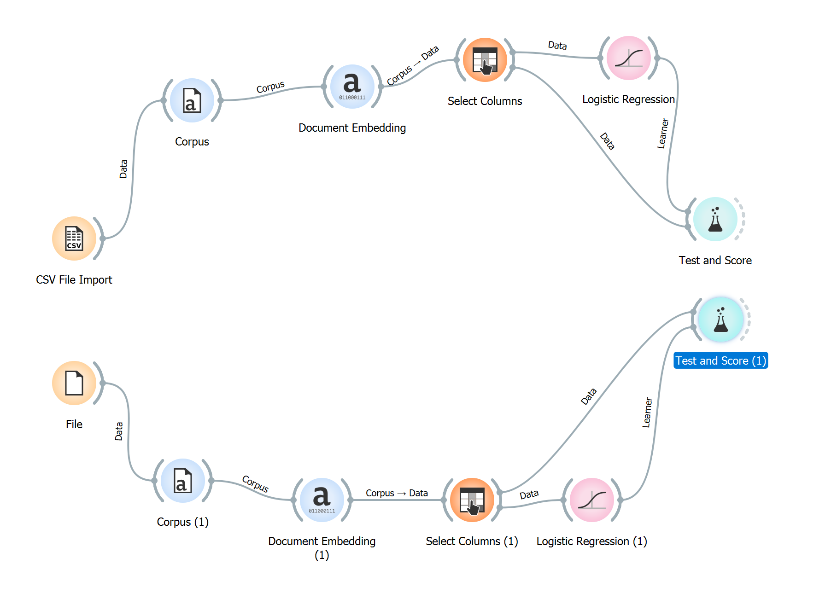
News Category – CSV file

Slide 16
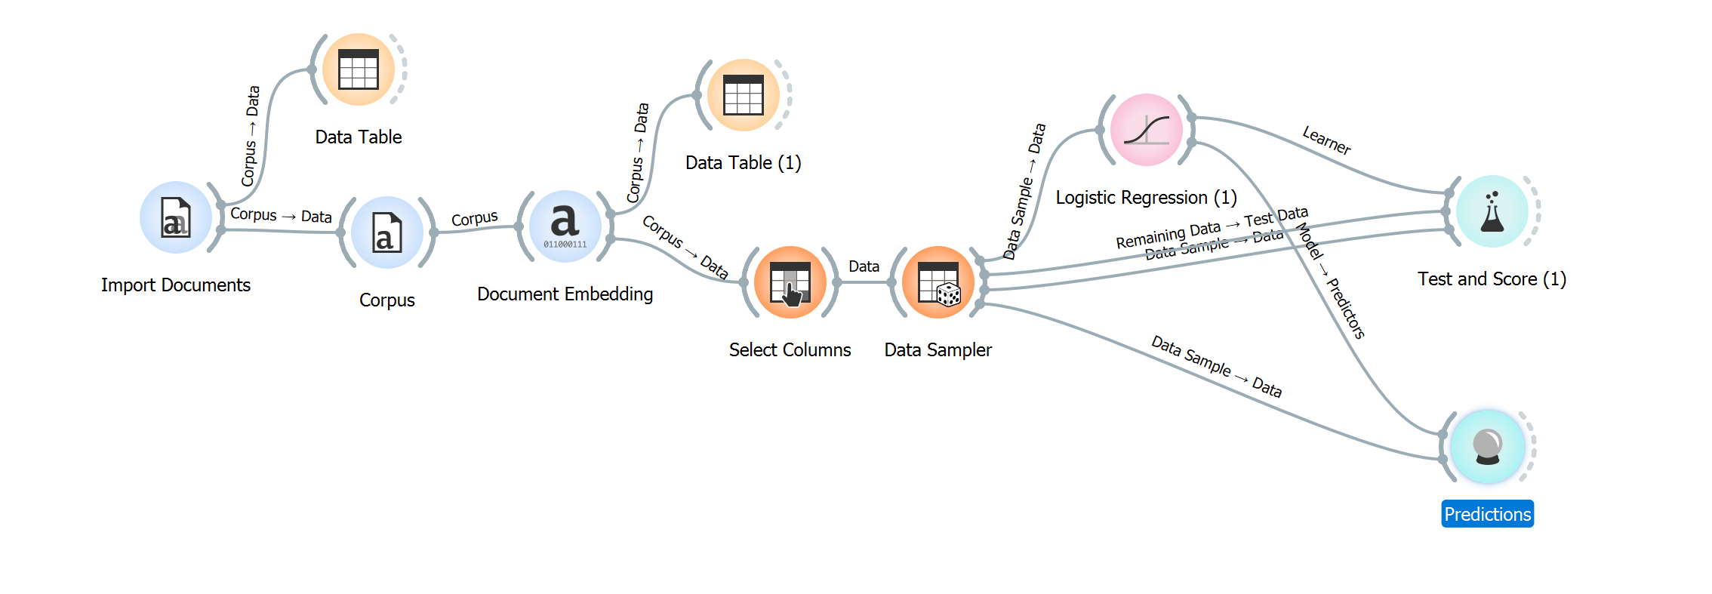
Movie Review – Text file

Slide 17
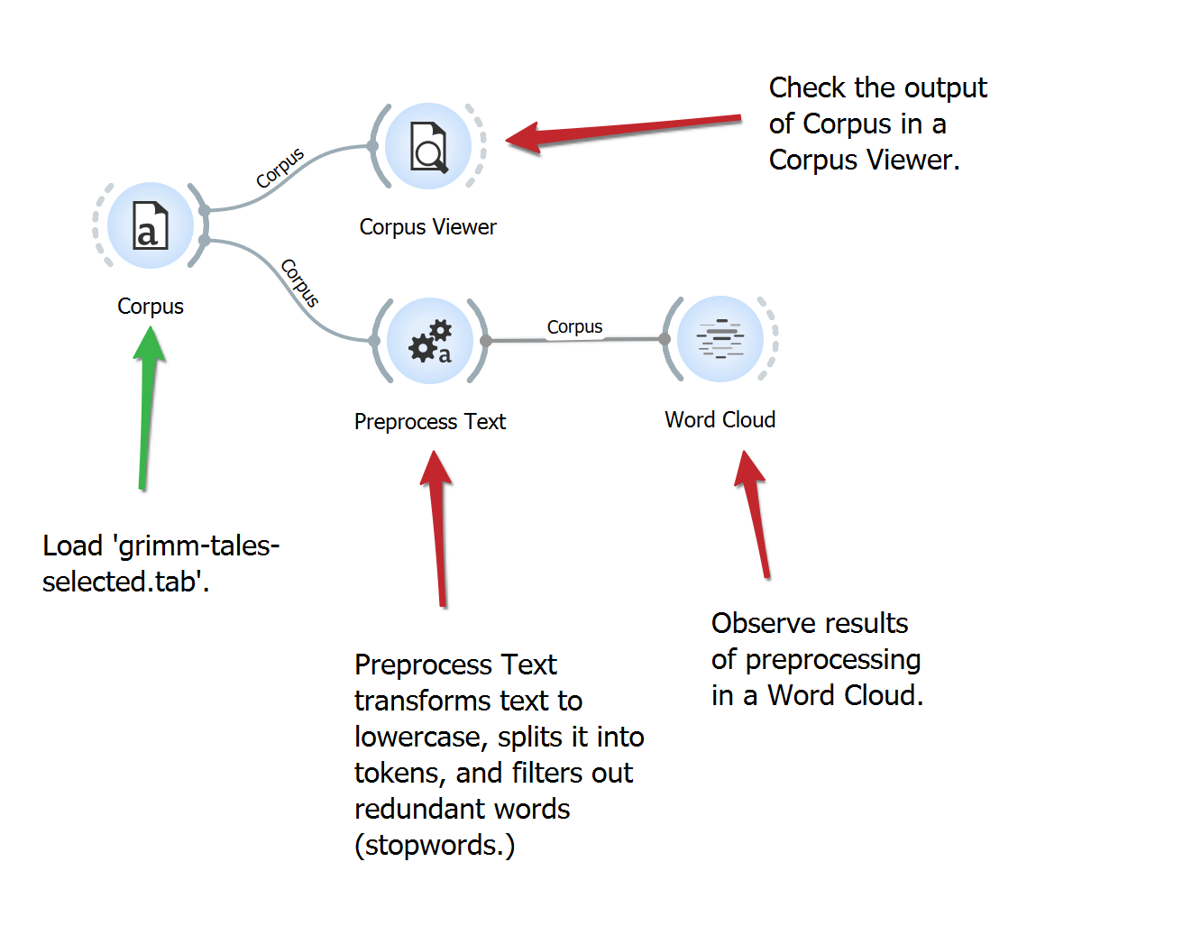
Word cloud and many others

Slide 18
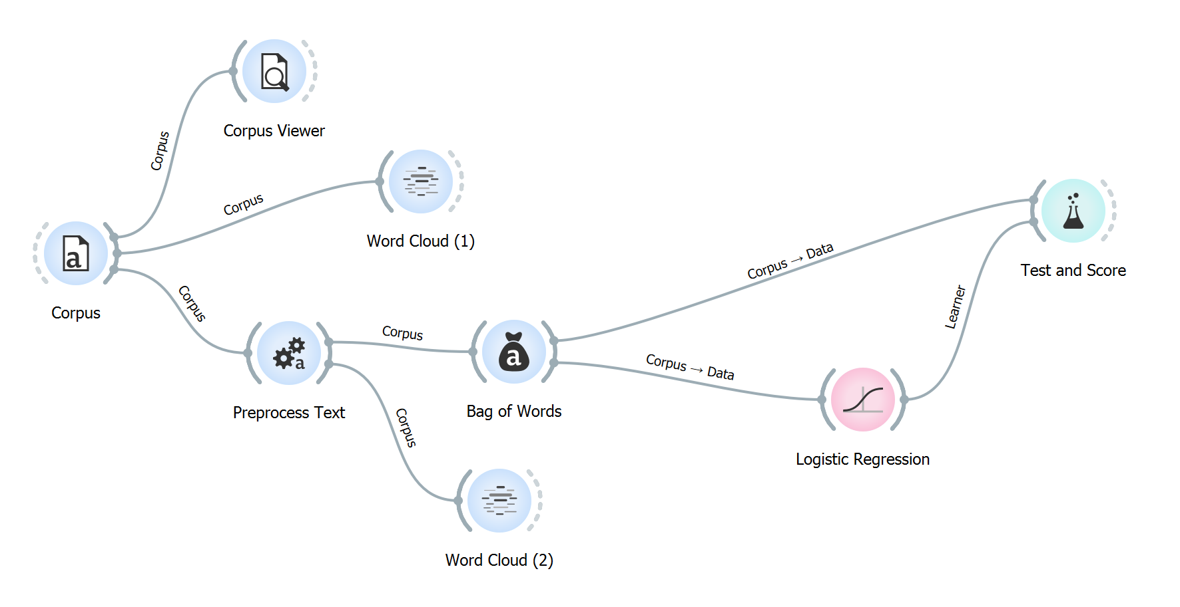
Classifier – types of tales – Grimm Tales from tab

Slide 19
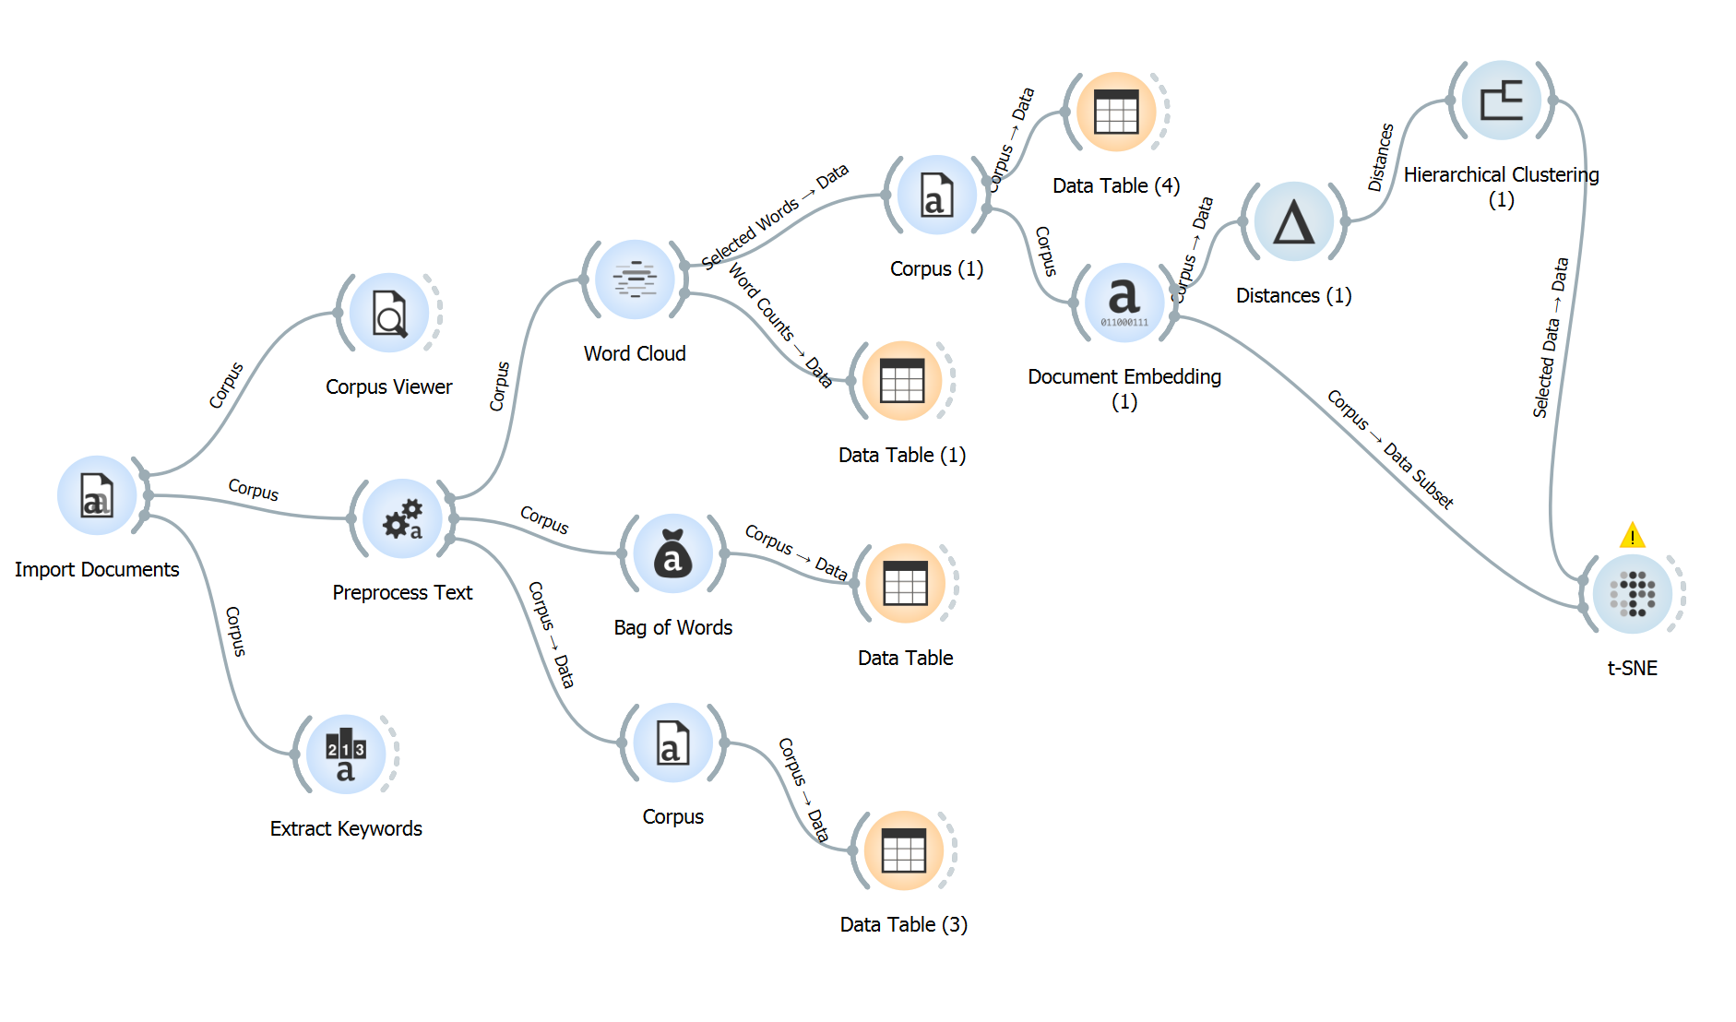
http://file.biolab.si/text-semantics/data/
http://file.biolab.si/text-semantics/data/proposals-to-government-1k/
Clustering (Proposal to Government)

Slide 20
images

Slide 21
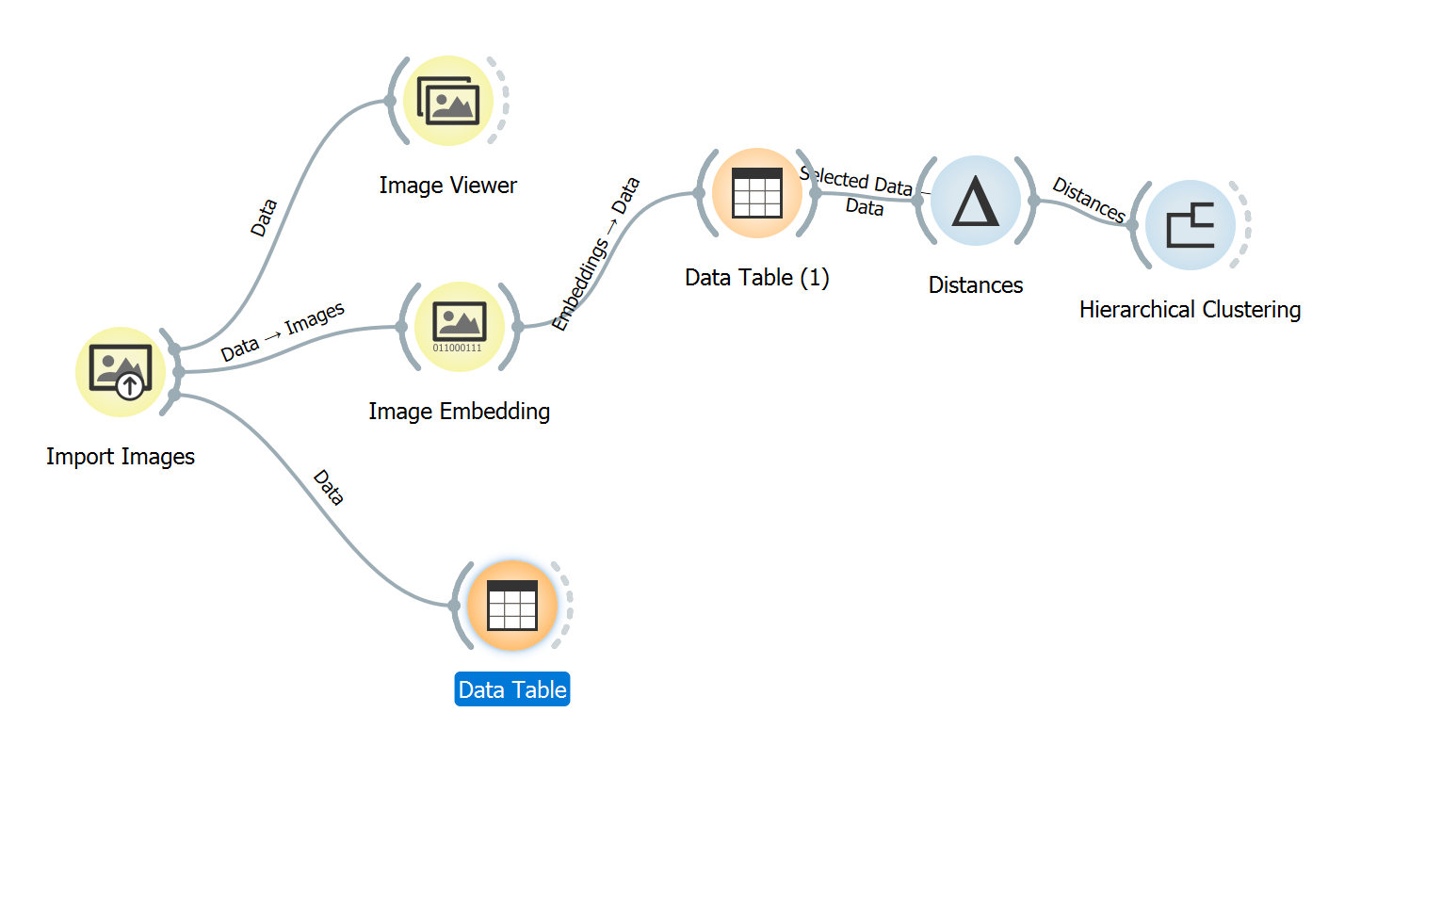
Clustering (Animal photo)

Slide 22
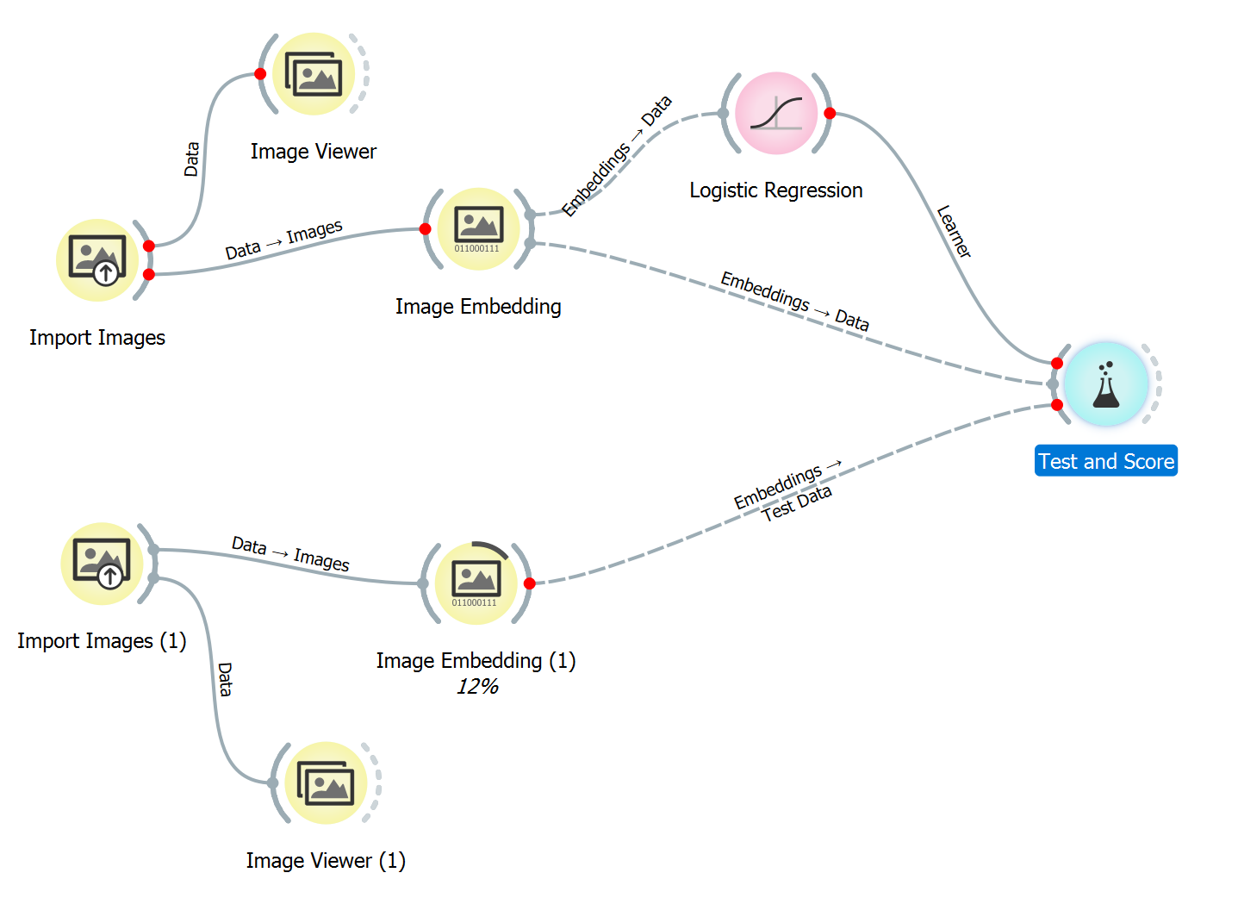
Classifier: Can CNN or Resnet do better ? Pneumonia Data

Slide 23
Example
http://file.biolab.si/text-semantics/data/
https://youtu.be/f5xR72y43Rs

